Slide 1
Lecture 3a
The Physical Layer (I): Transmission Media

Slide 2
So far …
Three scenarios
Circuit Vs Packet switching
Protocol stack
Layers
OSI and Internet

Slide 3
Starting Today: The PHY Layer
Slide modified from Agrawal
Definition: Provide transparent transmission of a bit stream over a circuit built from some physical communications medium
ATIS Telecom glossary
http://www.atis.org/glossary/default.aspx
Earlier versions
Federal Standard 1037C
http://www.its.bldrdoc.gov/fs-1037
ANS T1.523-2001, Telecom Glossary 2000
http://www.atis.org/tg2k/
ATIS = Alliance for Telecommunications Industry Solutions

Slide 4
Slide modified from Agrawal
CHAPTER 2
(more details than there)

Slide 5

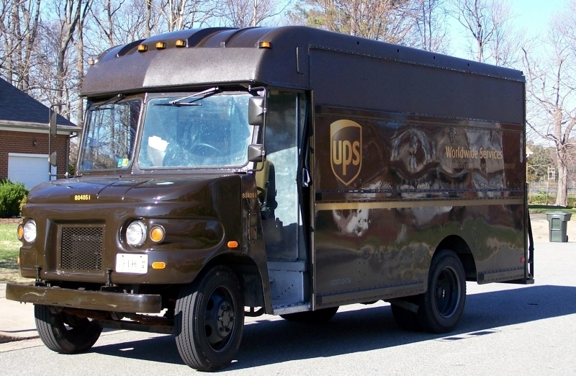
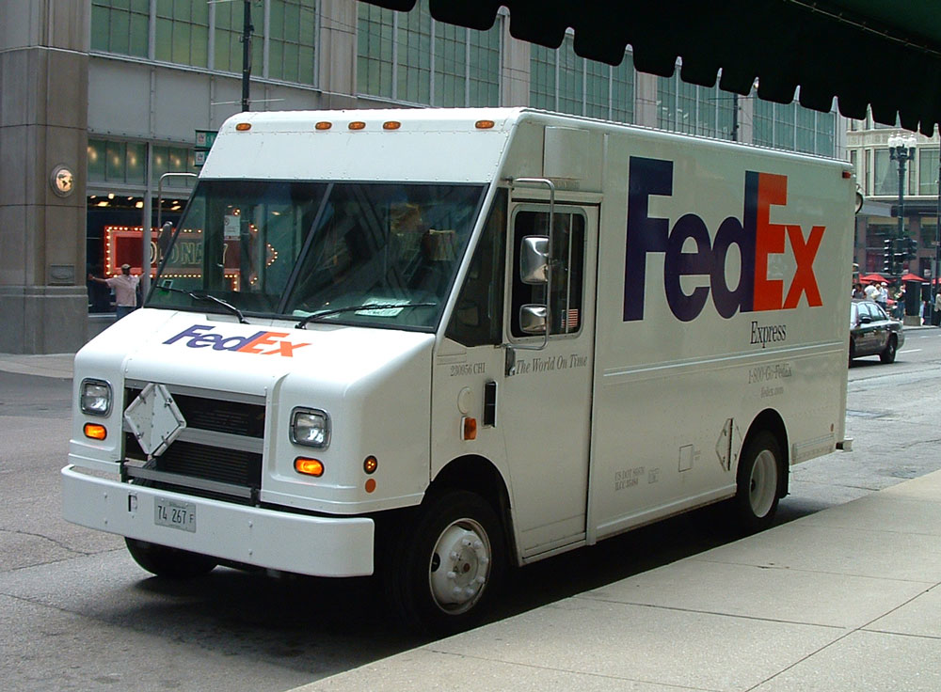


Position in the Protocol Stack
Slide modified from Agrawal
Voltage
Other PHY layers such as optical fiber, wireless

Slide 6
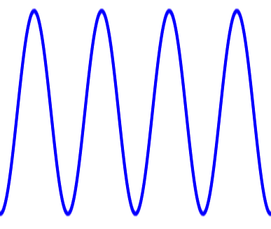
Context
A
B
Signal
Media
What is involved in getting information from A to B?
Media – what are different common transmission media?
Signals – what is a signal?
Bunch of other stuff (standards, protocols, etc.) to be discussed later

Slide 7
Special feature of the Physical Layer
Slide modified from Agrawal
Physical layer interacts with nature
Layer where we are at the mercy of nature
Depend upon wires, optical fibers or air to transmit signals
Signal transmitting properties of chosen media are important
Signals generated by physical layer comply with properties of the medium
Examples: voltages with copper, light with fiber, electromagnetic radiation (radio frequency or RF signals)

Slide 8
Physical media and their properties
Slide modified from Agrawal
The physical medium is the transmission path along which a signal propagates
Examples: a wire pair, coaxial cable, optical fiber, radio path
Media are chosen for their special properties that enable efficient transmission (movement) of signals
Example: most plastics cannot be used as physical media because they do not efficiently conduct electricity, light, heat or other forms of energy
Common media are copper wire, optical fiber, and air

Slide 9
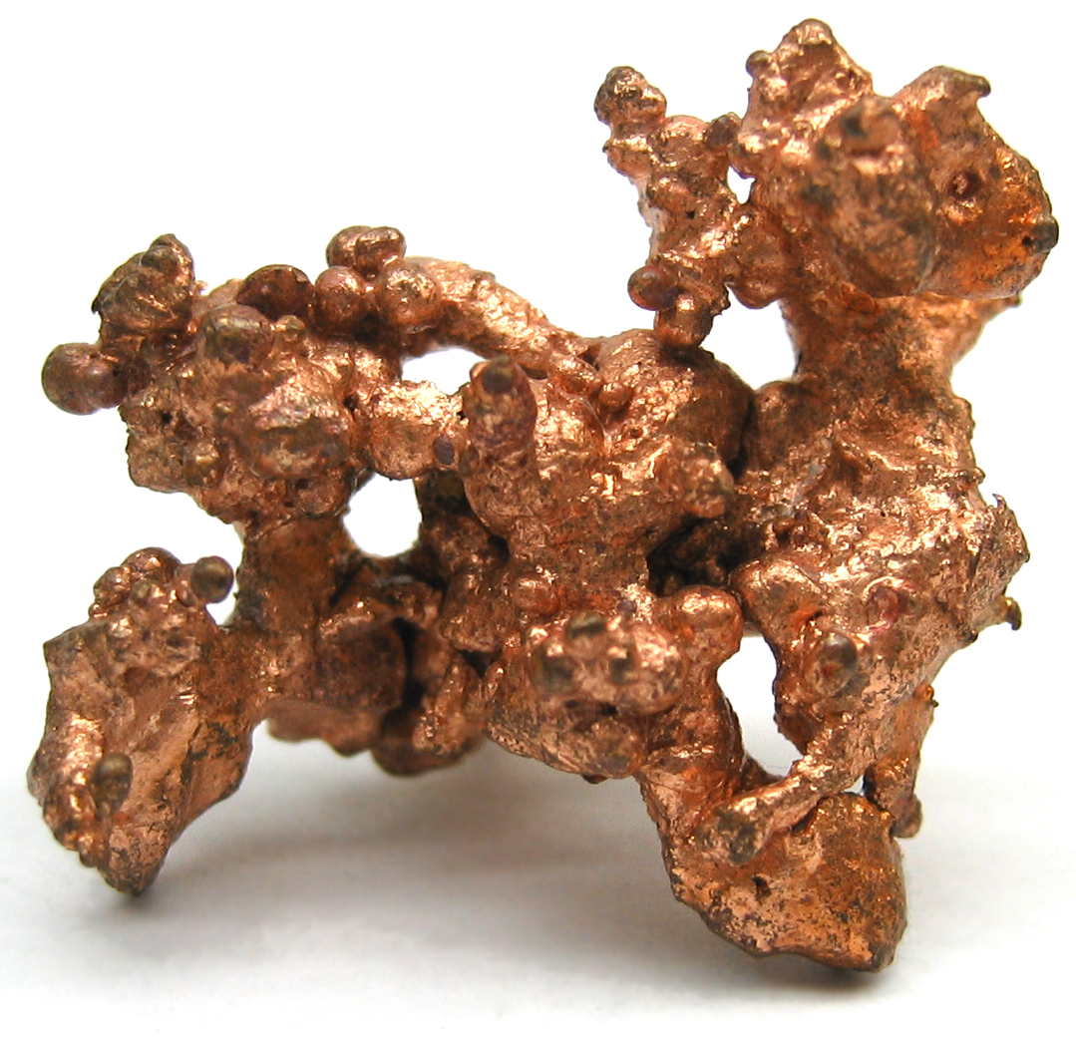

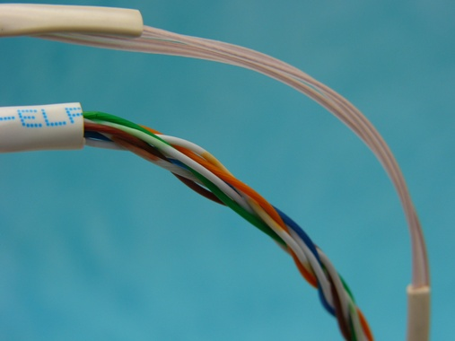
Copper wire as physical medium
Slide modified from Agrawal
Copper is a very good conductor of electricity and is relatively abundantly available
In computer networking
8 individual strands of copper wire are organized as four pairs
This is called Unshielded twisted-pair (UTP)
Each pair of wires is twisted around each other
Twisting reduces interference from induction
Tighter twisting improves data rates (reduces noise)
Cat 3 cable
Cat 5 cable

Slide 10
Categories of UTP cables
Slide modified from Agrawal
Categories range from Cat-1 to Cat-6
The higher the category, the higher the maximum possible data rate
And generally more twists-per-inch
http://en.wikipedia.org/wiki/Category_5_cable
Cable type | Max data rate
Cat 3 | 10 Mbps
Cat 5e | 1,000 Mbps = 1Gbps
Cat 6 | 10 Gbps
Unshielded Twisted Pair
Shielded Twisted Pair
Shield

Slide 11
UTP and STP Again
Figure Source: The Physical Layer of Communication Systems, by R.A. Thompson and Others
Electromagnetic energy passes through an insulator, but is stopped by metal. Thus STP is/has:
Lower noise susceptibility than UTP
Lower electromagnetic emissions than UTP
More expensive than UTP

Slide 12
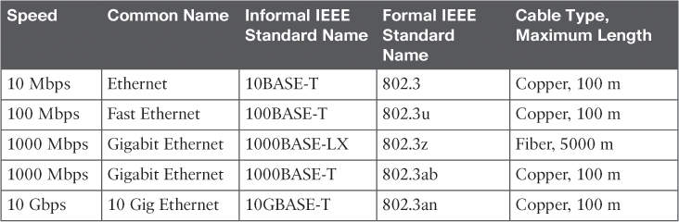
The Variety of Ethernet Physical Layer Standards
Notes:
The term Ethernet refers to an entire family of standards Some standards define the specifics of how to send data over a particular type of cabling, and at a particular speed. Other standards define protocols, or rules, that the Ethernet nodes must follow to be a part of an Ethernet LAN. All these Ethernet standards come from the IEEE and include the number 802.3 as the beginning part of the standard name.
Ethernet supports a large variety of options for physical Ethernet links given its long history over the last 40 or so years. Today, Ethernet includes many standards for different kinds of optical and copper cabling, and for speeds from 10 megabits per second (Mbps) up to 100 gigabits per second (Gbps). The standards also differ as far as the types of cabling and the allowed length of the cabling.
T stands for UTP, X stands for biger

Slide 13
Transmitting data using twisted pairs
Transmitter
Receiver
Notes:
While it is true that Ethernet sends data over UTP cables, the physical means to send the data uses electricity that flows over the wires inside the UTP cable. To better understand how Ethernet sends data using electricity, break the idea down into two parts: how to create an electrical circuit and then how to make that electrical signal communicate 1s and 0s.
First, to create one electrical circuit, Ethernet defines how to use the two wires inside a single twisted pair of wires. The figure does not show a UTP cable between two nodes, but instead shows two individual wires that are inside the UTP cable. An electrical circuit requires a complete loop, so the two nodes, using circuitry on their Ethernet ports, connect the wires in one pair to complete a loop, allowing electricity to flow.
To send data, the two devices follow some rules called an encoding scheme.
Note that in an actual UTP cable, the wires will be twisted together, instead of being parallel as shown in figure. The twisting helps solve some important physical transmission issues, like interference.

Slide 14
Cable connectors
Slide modified from Agrawal
Cat5e cables end in RJ 45 connectors for Ethernet
Not all pairs used in all cases
Some pairs are used for carrying DC power
Conductor identification | Color code | Use
Pair 1 | White-Blue/ Blue | -
Pair 2 | White-Orange/ Orange | Transmit data
Pair 3 | White-Green/ Green | Receive data
Pair 4 | White-Brown/ Brown | -
Notes:
To learn about how a UTP Ethernet link works, it helps to break down the physical link into those basic pieces, as shown in figure, the cable itself, the connectors on the ends of the cable, and the matching ports on the devices into which the connectors will be inserted.
First, think about the UTP cable itself. The cable holds some copper wires, grouped as twisted pairs. The 10BASE-T and 100 BASE-T standards require two pairs of wires, while the 1000BASE-T standard requires four pairs. Each wire has a color-coded plastic coating, with the wires in a pair having a color scheme. For example, for the blue wire pair, one wire’s coating is all blud, while the other wire’s coating is blue-and-white striped.
Many Ethernet UTP cables use an RJ-45 connector on both ends. The RJ-45 connector has eight physical locations into which the eight wires in the cable can be inserted, called pin positions, or simply pins. These pins create a place where the ends of the copper wires can touch the electronics inside the nodes at the end of the physical link so that electricity can flow.
To complete the physical link, the nodes each need an RJ-45 Ethernet port that matches the RJ-45 connectors on the cable so that the connectors on the ends of the cable can connect to each node. PCs often include this RJ-45 Ethernet port as part of a network interface card (NIC), which can be an expansion card on the PC or can be built in to the system itself. Switches typically have many RJ-45 ports because switches give user devices a place to connect to the Ethernet LAN.

Slide 15
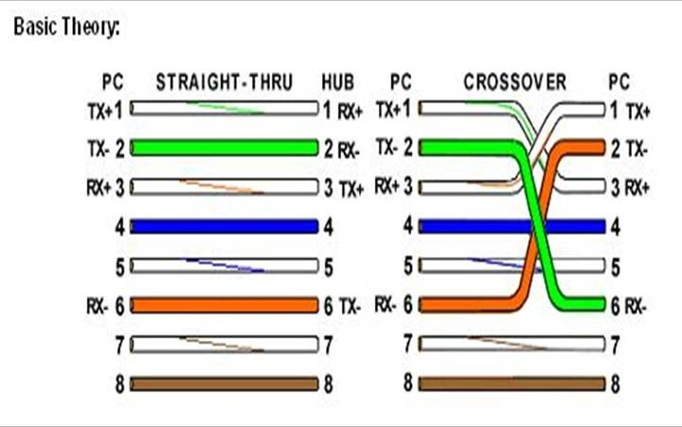
UTP Cabling Pinouts for 10BASE-T and 100 BASE-T
Straight-Through Cable Pinout
Cross-over cable
Notes:
Straight-through cable: 10BASE-T and 100BASE-T use two pairs of wires in a UTP cable, one for each direction, as shown in figure. The figure shows four wires, all of which sit inside a single UTP cable that connects a PC and a LAN hub. In this example, the PC on the left transmits using the top pair, and the hub on the right transmits using the bottom pair. For correct transmission over the link, the wires in the UTP cable must be connected to the correct pin positions in the RJ-45 connectors. For example, in figure, the transmitter on the PC on the left must know the pin positions of the two wires it should use to transmit. Those two wires must be connected to the correct pins in the RJ-45 connector on the hub, so that the hub’s receiver logic can use the correct wires.
To understand the wiring of the cable-which wires need to be in which pin positions on both ends of the cable-you need to first understand how the NICs and hubs work. As a rule, Ethernet NIC transmitters use the pair connected to pins 1 and 2; the NIC receivers use a pair of wires at pin positions 3 and 6. LAN hubs, knowing those facts about what Ethernet NICs do, do the opposite: Their receivers use the wire pair at pins 1 and 2, and their transmitters use the wire pair at pins 3 and 6.
To allow a PC NIC to communicate with a hub, the UTP cable must also use a straight-through cable pinout. The term poinout refers to the wiring of which color wire is placed in each of the eight numbered pin positions in the RJ-45 connector. An Ethernet straight-through cable connects the wire at pin 1 on one end of the cable to pin 1 at the other end of the cable; the wire at pin 2 needs to connect to pin 2 on the other end of the cable; pin 3 on one end connects to pin 3 on the other, and so on. Also, it uses the wires in one wire pair at pins 1 and 2, and another pair at pins 3 and 6.
Crossover cable pinouts: A straight-through cable works correctly when the nodes use opposite pairs for transmitting data. However, when two like devices connect to an Ethernet link, they both transmit on the same pins. In that case, you then need another type of cabling pinout called a crossover cable. The crossover cable pinout crosses the pair at the transmit pins on each device to the receive pins on the opposite device. The figure whos what happens on the link between two PCs. The two PCs both transmit on the pair at pin 1 and 2, and they both receive on the pair at pins 3 and 6. So, the cable must connect a pair at pins 1 and 2 on each side to pins 3 and 6 on the other side, connecting to the other node’s receiver logic.

Slide 16
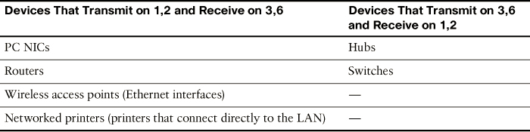
UTP Cabling Pinouts for 10BASE-T and 100 BASE-T

Slide 17
UTP Cabling Pinouts for 10BASE-T and 100 BASE-T
Questions: which cable you should use, straight-through cable or crossover cable when
Connect PC to PC
Connect PC to Switch
Connect Switch to Switch

Slide 18
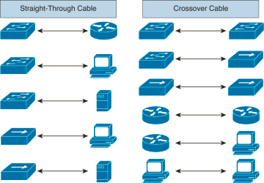
UTP Cabling Pinouts for 10BASE-T and 100 BASE-T

Slide 19
Coaxial cable
Figure Source: The Physical Layer of Communication Systems, by R.A. Thompson and Others
Applications
Ethernet (until circa 1987)
Cable TV
IBM terminal connections
Good propagation characteristics
Larger bandwidth
Can be unwieldy to manage
Flexible
Semi rigid
Inner strands

Slide 20
Copper is Used Almost Everywhere
Example: USB SuperSpeed
Notice wire for power
Notice how many wires are squeezed in the cable
5 Gbps
Short length!
Source: SuperSpeed USB PHY Layer Specification
Presentation by Howard Heck, Intel

Slide 21

Why not copper?
Great for short distances
Local networking or communications! (where the word LAN comes from)
Attenuation and loss (to be visited) requiring repeaters
Noise may add up
Long haul networks use optical fiber
Data rates are limited
10 Gbps or so
Weight and so cost of installation
Needs mining – compare with glass
More robust
http://1800recycling.com/wp-content/uploads/2013/04/Earth-Day-hands.jpg

Slide 22
Optical fiber as physical medium
Slide modified from Agrawal
Optical fiber is a thin strand of glass that guides light along its length
Can carry large volumes of data over long distances
Larger pipe – two lane Versus four lane highway
Typically aggregate traffic is carried over fiber in long-haul links
Local networks are also using optical fiber
FiOS = Fiber To The Home (FTTH) or Fiber to the Premises (FTTP)
Optical Fiber is now in the access network

Slide 23
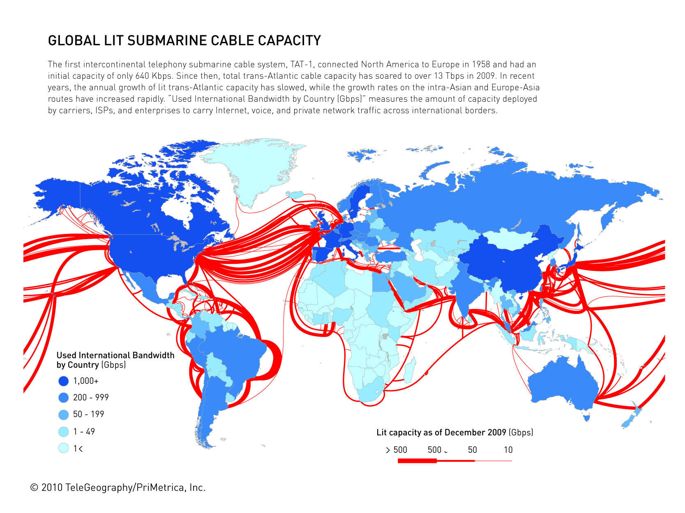
Submarine optical fiber installation
Slide modified from Agrawal
http://www.submarinecablemap.com
Reliability?

Slide 24

Optical fiber as Physical medium
Slide modified from Agrawal
(rare)
Glass is a good conductor of light
Not heavy and made from sand, which is abundantly available
Works on the principle of Total Internal Reflection
Light can escape only if it hits the wall at right angles
Since there is little energy loss, fiber can transmit signals over huge distances without repeaters
(dense)

Slide 25
Principle of Operation of Optical Fibers
Incident Light
Reflected Light
Normal Refraction
Higher Refraction Index
Lower Refraction Index
Refracted
Light
Total Internal
Reflection
Incident Light
Reflected Light
Higher Refraction Index
Lower Refraction Index
Notes:
This refractive index works with any boundary, such as glass and water as well.

Slide 26
Characteristics of Optical Fibers
Uses light impulses instead of electrical signals
Properties and characteristics
Very high bandwidth
Very high noise immunity
Much less susceptible to noise, but subject to signal dispersion that results in intersymbol interference

Slide 27
Types of optical fiber
Slide modified from Agrawal
Multiple mode
50 - 100 microns in diameter
Uses LED as light source (less expensive)
Can transmit data over short-to-medium distances
Used on short links (upto about 2000 m)
Single mode
About 10 microns in diameter
Uses Laser light source
Can transmit data over very long distances
Used on trunk routes
1 micron = 1 μm = 10⁻⁶ m

Slide 28
Construction of optical fiber
Slide modified from Agrawal
Core has high refractive index
Cladding has low refractive index
Together, they keep light inside the optical fiber

Slide 29
Wireless
NOT PHYSICAL, yet physical layer
Provides “tether-free” communications
Convenience, mobility
Wireless communication system
Any communication system that uses a naturally occurring communication medium, such as air, water, earth.
Examples:
Cell phone, sonar, ground penetrating radar
Broadcast: (one way)
Radio, TV, pagers, satellite TV
Two Way:
Walkie talkie, cell phones, satellite phones, WiFi, Bluetooth
Fundamentally different from wired networks

Slide 30
Radio Spectrum
One part of Electromagnetic Waves.
When electrons move, they create electromagnetic waves that can propagate through space (even in vacuum).

Slide 31
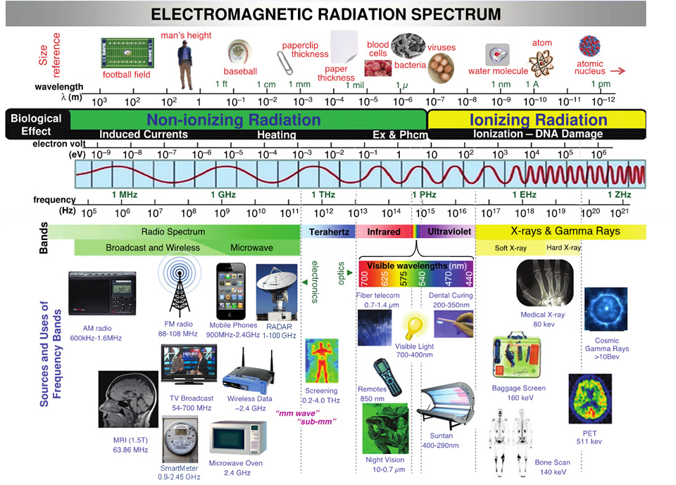

Slide 32

Radio Spectrum

Slide 33
Electromagnetic wave
Frequency: the number of oscillations per second of a wave, measured in Hz
Wavelength: distance between two consecutive maxima
Wavelength = c/f

Slide 34
Narrow vs Broadband
Most transmission use a relatively narrow frequency band.
However, in some cases, a wider band is used:
Frequency hopping spread spectrum
Direct sequence spread spectrum (CDMA)
Ultra Wide Band

Slide 35
Mobile Vs. Wireless
Mobile and Wireless are not interchangeable
Mobile and wireless communication systems
Communicate over the air via radio-waves
Support some form of user mobility
Mobile | Wireless | Example
✗ | ✗ | Desktop computer with Ethernet, pay phone
✗ | ✓ | Wireless local loop
✓ | ✗ | Calling card, call forwarding
✓ | ✓ | Cell phone, laptop with WLAN

Slide 36
Transmission Medium = Air
It is hard, if not impossible to slice wireless transmissions in “space”
New technologies like MIMO try to do some of this
The common way of slicing spectrum is to “allocate” different frequency bands to different applications and service providers over different geographical areas
Power, frequency bands, applications, receiver capability, all impact wireless
Typically uses electromagnetic radiation, not light impulses or electrical voltages/currents for communication

Slide 37
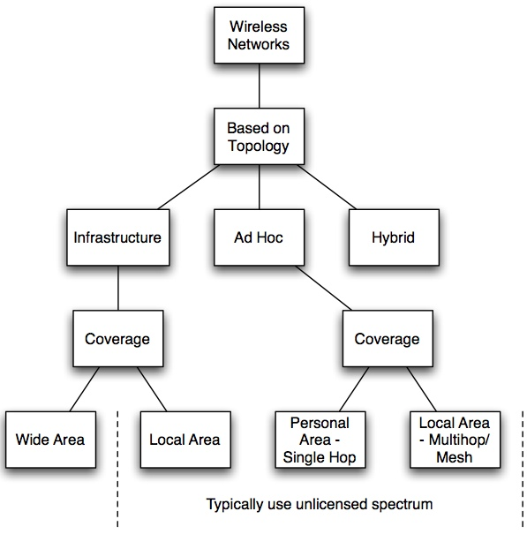
Spectrum allocation
The Federal Communications Commission (FCC) regulates spectrum in the US
Licensed Vs Unlicensed
Auctions
Minimum bid in UK for one piece (30 MHz) of spectrum was 125 million pounds

Slide 38
Wired Vs. Wireless Example
Wireless has much different behavior and issues compared to wired networks
LAN Design
Selection of technology (e.g., 100 Mbps, 1 Gbps, 10Gbps Ethernet) and cabling (e.g., coax, twisted pair, optical; plenum vs. nonplenum).
WLAN Design selection of technology (e.g., 802.11 a/b/g/n/ac) and AP Placement based on
Signal coverage and capacity
Power level and access to AC power
Frequency channel selection
Connection to wired infrastructure
Take measurements to get signal quality map
-80 dBm
-80 dBm

Slide 39
Wireless also needs Antennas
A transducer for converting guided signals in a transmission line or waveguide into electromagnetic radiation in an unbounded medium or vice versa
Any conductor or dielectric can serve as the transducer <link> (http://www.oreillynet.com/cs/weblog/view/wlg/448)
The properties may make it inefficient and thus unsuitable for the application
Thin Dipole
Biconical Dipole
Loop
Parabolic
Reflector
Microstrip
Horn
Antenna

Slide 40
Key Takeaways – transmission media
Cable type | Cost | Ease of use | Capacity | Noise Susceptibility | EM radiation (interference)
Twisted pair | Low | High | Low | High | High
Coax | Medium | Medium | Good | Lower | Lower
Multimode Fiber | Medium | Medium | High | Very low | Almost zero
Single mode fiber | Highest | Lowest | Highest | Very low | Almost zero
Wireless | Variable | Variable | Low | High | High

Slide 41
Next class
Signals, bandwidth, and other physical layer issues
Please install {R-studio and R} or Matlab on your computers

